Slide 1
Dot products and correlations
Tom Jhou

Slide 2
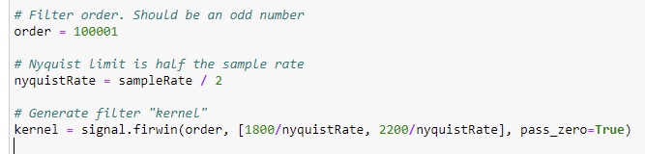
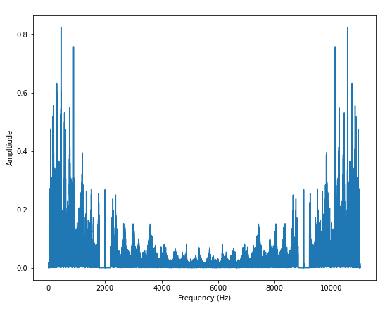
Homework review:

Slide 3
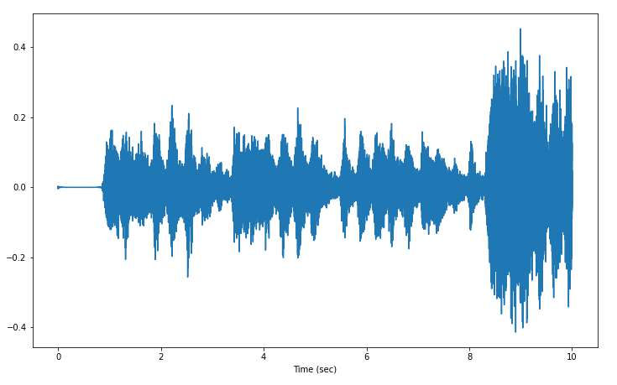
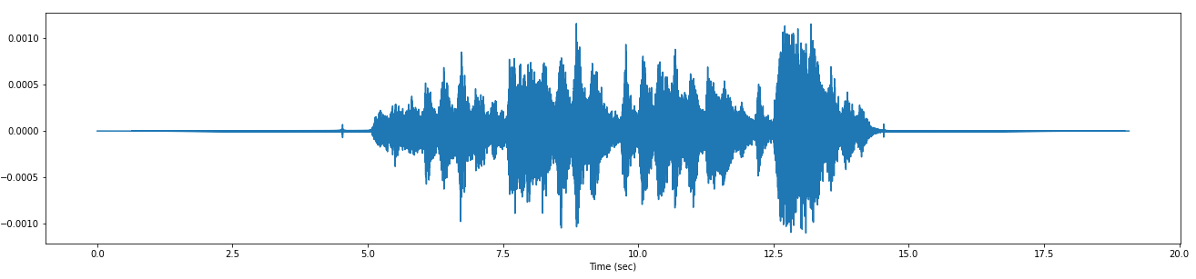
Did you notice that output is longer than input?
Original audio clip
Recovered audio clip

Slide 4

Let’s revisit convolution with finite kernel length = 5
$${ f}_{0},{ f}_{1}, { f}_{2},{ f}_{3}, { f}_{4},{ f}_{5},{ f}_{6},{ f}_{7},{ f}_{8}$$
$${ g}_{4}, { g}_{3}, { g}_{2},{ g}_{1}, { g}_{0}$$

Slide 5
t = 0
$${ f}_{0},{ f}_{1}, { f}_{2},{ f}_{3}, { f}_{4},{ f}_{5},{ f}_{6},{ f}_{7},{ f}_{8}$$
$${ g}_{4}, { g}_{3}, { g}_{2},{ g}_{1}, { g}_{0}$$

Slide 6

t = 1
$${ f}_{0},{ f}_{1}, { f}_{2},{ f}_{3}, { f}_{4},{ f}_{5},{ f}_{6},{ f}_{7},{ f}_{8}$$
$${ g}_{4}, { g}_{3}, { g}_{2},{ g}_{1}, { g}_{0}$$

Slide 7

t = 2
$${ f}_{0},{ f}_{1}, { f}_{2},{ f}_{3}, { f}_{4},{ f}_{5},{ f}_{6},{ f}_{7},{ f}_{8}$$
$${ g}_{4}, { g}_{3}, { g}_{2},{ g}_{1}, { g}_{0}$$

Slide 8

t = 3
$${ f}_{0},{ f}_{1}, { f}_{2},{ f}_{3}, { f}_{4},{ f}_{5},{ f}_{6},{ f}_{7},{ f}_{8}$$
$$g_{4}, { g}_{3}, g_{2},{ g}_{1}, g_{0}$$

Slide 9

t = 4
$${ f}_{0},{ f}_{1}, { f}_{2},{ f}_{3}, { f}_{4},{ f}_{5},{ f}_{6},{ f}_{7},{ f}_{8}$$
$$g_{4}, { g}_{3}, g_{2},{ g}_{1}, g_{0}$$

Slide 10

t = 5
$${ f}_{0},{ f}_{1}, { f}_{2},{ f}_{3}, { f}_{4},{ f}_{5},{ f}_{6},{ f}_{7},{ f}_{8}$$
$$g_{4}, { g}_{3}, g_{2},{ g}_{1}, g_{0}$$

Slide 11

t = 6
$${ f}_{0},{ f}_{1}, { f}_{2},{ f}_{3}, { f}_{4},{ f}_{5},{ f}_{6},{ f}_{7},{ f}_{8}$$
$$g_{4}, { g}_{3}, g_{2},{ g}_{1}, g_{0}$$

Slide 12

t = 7
$${ f}_{0},{ f}_{1}, { f}_{2},{ f}_{3}, { f}_{4},{ f}_{5},{ f}_{6},{ f}_{7},{ f}_{8}$$
$$g_{4}, { g}_{3}, g_{2},g_{1}, g_{0}$$

Slide 13

t = 8
$${ f}_{0},{ f}_{1}, { f}_{2},{ f}_{3}, { f}_{4},{ f}_{5},{ f}_{6},{ f}_{7},{ f}_{8}$$
$$g_{4}, { g}_{3}, g_{2},g_{1}, g_{0}$$

Slide 14

t = 9
$${ f}_{0},{ f}_{1}, { f}_{2},{ f}_{3}, { f}_{4},{ f}_{5},{ f}_{6},{ f}_{7},{ f}_{8}$$
$$g_{4}, { g}_{3}, g_{2},g_{1}, g_{0}$$

Slide 15

t = 10
$${ f}_{0},{ f}_{1}, { f}_{2},{ f}_{3}, { f}_{4},{ f}_{5},{ f}_{6},{ f}_{7},{ f}_{8}$$
$$g_{4}, { g}_{3}, g_{2},g_{1}, g_{0}$$

Slide 16

t = 11
$${ f}_{0},{ f}_{1}, { f}_{2},{ f}_{3}, { f}_{4},{ f}_{5},{ f}_{6},{ f}_{7},{ f}_{8}$$
$$g_{4}, { g}_{3}, g_{2},g_{1}, g_{0}$$

Slide 17
t = 12
$${ f}_{0},{ f}_{1}, { f}_{2},{ f}_{3}, { f}_{4},{ f}_{5},{ f}_{6},{ f}_{7},{ f}_{8}$$
$$g_{4}, { g}_{3}, g_{2},g_{1}, g_{0}$$

Slide 18
Output goes from t=0 to 12, i.e. has 13 samples.
Input = 9 samples
Kernel = 5 samples
Output length
= 9 + 5 – 1
= 14 – 1
= 13

Slide 19
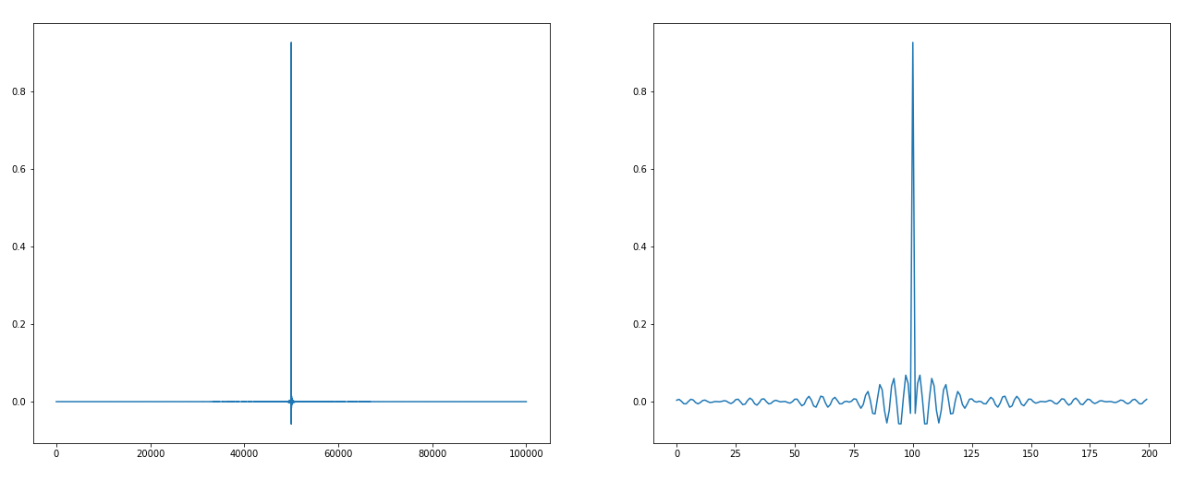
Did anybody plot the kernel?:
plt.plot(kernel)

Slide 20
Note peak at exact center
plt.plot(kernel)
50,001
100,001

Slide 21
Zoom into center:
plt.plot(kernel[49900:50100])

Slide 22
Two component: central peak, plus side wiggles.
plt.plot(kernel[49900:50100])

Slide 23
Consider central peak alone:

Slide 24

Make smaller example: g₂ = 1, everything else = 0
$${ f}_{0},{ f}_{1}, { f}_{2},{ f}_{3}, { f}_{4},{ f}_{5},{ f}_{6},{ f}_{7},{ f}_{8}$$
$${ g}_{4}, { g}_{3}, { g}_{2},{ g}_{1}, { g}_{0}$$

Slide 25

t = 0, output = 0
$${ f}_{0},{ f}_{1}, { f}_{2},{ f}_{3}, { f}_{4},{ f}_{5},{ f}_{6},{ f}_{7},{ f}_{8}$$
$${ g}_{4}, { g}_{3}, { g}_{2},{ g}_{1}, { g}_{0}$$

Slide 26

t = 1, output = 0
$${ f}_{0},{ f}_{1}, { f}_{2},{ f}_{3}, { f}_{4},{ f}_{5},{ f}_{6},{ f}_{7},{ f}_{8}$$
$${ g}_{4}, { g}_{3}, { g}_{2},{ g}_{1}, { g}_{0}$$

Slide 27

t = 2, output = f₀
$${ f}_{0},{ f}_{1}, { f}_{2},{ f}_{3}, { f}_{4},{ f}_{5},{ f}_{6},{ f}_{7},{ f}_{8}$$
$${ g}_{4}, { g}_{3}, { g}_{2},{ g}_{1}, { g}_{0}$$

Slide 28

t = 3, output = f₁
$${ f}_{0},{ f}_{1}, { f}_{2},{ f}_{3}, { f}_{4},{ f}_{5},{ f}_{6},{ f}_{7},{ f}_{8}$$
$$g_{4}, { g}_{3}, g_{2},{ g}_{1}, g_{0}$$

Slide 29

t = 4, output = f₂
$${ f}_{0},{ f}_{1}, { f}_{2},{ f}_{3}, { f}_{4},{ f}_{5},{ f}_{6},{ f}_{7},{ f}_{8}$$
$$g_{4}, { g}_{3}, g_{2},{ g}_{1}, g_{0}$$

Slide 30

t = 5, output = f₃
$${ f}_{0},{ f}_{1}, { f}_{2},{ f}_{3}, { f}_{4},{ f}_{5},{ f}_{6},{ f}_{7},{ f}_{8}$$
$$g_{4}, { g}_{3}, g_{2},{ g}_{1}, g_{0}$$

Slide 31

t = 6, output = f₄
$${ f}_{0},{ f}_{1}, { f}_{2},{ f}_{3}, { f}_{4},{ f}_{5},{ f}_{6},{ f}_{7},{ f}_{8}$$
$$g_{4}, { g}_{3}, g_{2},{ g}_{1}, g_{0}$$

Slide 32

t = 7, output = f₅
$${ f}_{0},{ f}_{1}, { f}_{2},{ f}_{3}, { f}_{4},{ f}_{5},{ f}_{6},{ f}_{7},{ f}_{8}$$
$$g_{4}, { g}_{3}, g_{2},g_{1}, g_{0}$$

Slide 33

t = 8, output = f₆
$${ f}_{0},{ f}_{1}, { f}_{2},{ f}_{3}, { f}_{4},{ f}_{5},{ f}_{6},{ f}_{7},{ f}_{8}$$
$$g_{4}, { g}_{3}, g_{2},g_{1}, g_{0}$$

Slide 34

t = 9, output = f₇
$${ f}_{0},{ f}_{1}, { f}_{2},{ f}_{3}, { f}_{4},{ f}_{5},{ f}_{6},{ f}_{7},{ f}_{8}$$
$$g_{4}, { g}_{3}, g_{2},g_{1}, g_{0}$$

Slide 35

t = 10, output = f₈
$${ f}_{0},{ f}_{1}, { f}_{2},{ f}_{3}, { f}_{4},{ f}_{5},{ f}_{6},{ f}_{7},{ f}_{8}$$
$$g_{4}, { g}_{3}, g_{2},g_{1}, g_{0}$$

Slide 36
Output is delayed by 2 samples, but otherwise unchanged.
Delay = (kernel length – 1) / 2
In small example, delay = (5-1)/2 = 2
In homework, delay = (100000-1)/2 = 50,000

Slide 37
Now consider side wiggles:

Slide 38
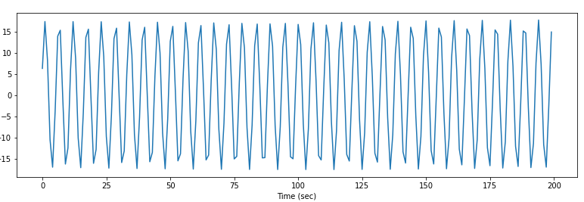
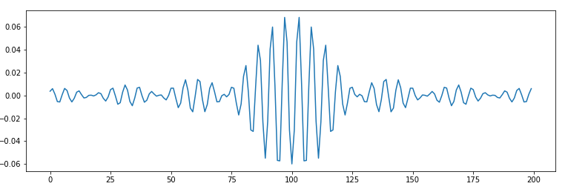
The wiggle frequency matches noise frequency:
2kHz noise
Kernel (minus central peak)

Slide 39
This is a band-pass filter.
Convolving this with 2kHz sinusoid gives “constructive interference”.
Other frequencies will give destructive interference, and be attenuated.
Kernel (minus central peak)

Slide 40
Note that it has negative value where the central spike was positive
This causes 2kHz components to be subtracted, rather than added
Kernel (minus central peak)

Slide 41
This kernel takes original signal, and subtracts 2kHz components
Result is a “band-stop” filter.

Slide 42
Fourier transform can be inverted
f1 = np.fft.fft(x)
f2 = np.fft.ifft(y)
f2 will look just like x

Slide 43
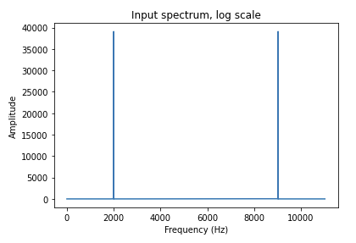
One way to implement filter is to take fft, “edit” the frequencies, then invert

Slide 44
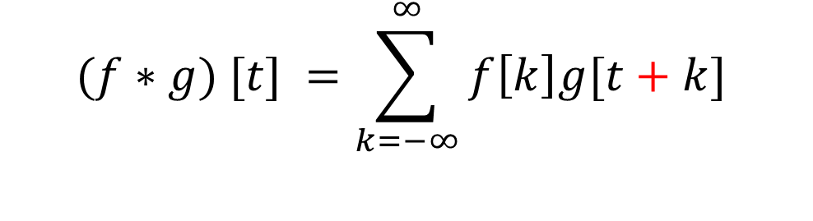
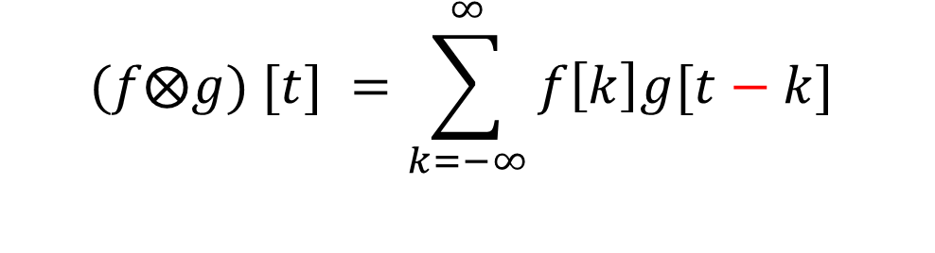
Convolution and cross-correlation are very related:
$$(f⨂g) [t] =\sum_{k=−∞}^{∞}{f\left[k\right]g[t−k}]$$
Convolution:
$$(f∗g) [t] =\sum_{k=−∞}^{∞}{f\left[k\right]g[t+k}]$$
Cross-correlation:
The only difference is that in convolution, g is flipped backwards.

Slide 45


t = 0
$${ f}_{0},{ f}_{1}, { f}_{2},{ f}_{3}, { f}_{4},{ f}_{5},{ f}_{6},{ f}_{7},{ f}_{8}$$
$$g_{4}, { g}_{3}, g_{2},{ g}_{1}, g_{0}$$
$${ f}_{0},{ f}_{1}, { f}_{2},{ f}_{3}, { f}_{4},{ f}_{5},{ f}_{6},{ f}_{7},{ f}_{8}$$
$$g_{0}, { g}_{1}, g_{2},{ g}_{3}, g_{4}, g_{5},g_{6}, g_{7}$$

Slide 46


t = 1
$${ f}_{0},{ f}_{1}, { f}_{2},{ f}_{3}, { f}_{4},{ f}_{5},{ f}_{6},{ f}_{7},{ f}_{8}$$
$$g_{4}, { g}_{3}, g_{2},{ g}_{1}, g_{0}$$
$${ f}_{0},{ f}_{1}, { f}_{2},{ f}_{3}, { f}_{4},{ f}_{5},{ f}_{6},{ f}_{7},{ f}_{8}$$
$$g_{0}, { g}_{1}, g_{2},{ g}_{3}, g_{4}, g_{5},g_{6}, g_{7}$$

Slide 47


t = 2
$${ f}_{0},{ f}_{1}, { f}_{2},{ f}_{3}, { f}_{4},{ f}_{5},{ f}_{6},{ f}_{7},{ f}_{8}$$
$$g_{4}, { g}_{3}, g_{2},{ g}_{1}, g_{0}$$
$${ f}_{0},{ f}_{1}, { f}_{2},{ f}_{3}, { f}_{4},{ f}_{5},{ f}_{6},{ f}_{7},{ f}_{8}$$
$$g_{0}, { g}_{1}, g_{2},{ g}_{3}, g_{4}, g_{5},g_{6}, g_{7}$$

Slide 48

t = 3
$${ f}_{0},{ f}_{1}, { f}_{2},{ f}_{3}, { f}_{4},{ f}_{5},{ f}_{6},{ f}_{7},{ f}_{8}$$
$$g_{4}, { g}_{3}, g_{2},{ g}_{1}, g_{0}$$
$${ f}_{0},{ f}_{1}, { f}_{2},{ f}_{3}, { f}_{4},{ f}_{5},{ f}_{6},{ f}_{7},{ f}_{8}$$
$$g_{0}, { g}_{1}, g_{2},{ g}_{3}, g_{4}, g_{5},g_{6}, g_{7}$$

Slide 49


t = 4
$${ f}_{0},{ f}_{1}, { f}_{2},{ f}_{3}, { f}_{4},{ f}_{5},{ f}_{6},{ f}_{7},{ f}_{8}$$
$$g_{4}, { g}_{3}, g_{2},{ g}_{1}, g_{0}$$
$${ f}_{0},{ f}_{1}, { f}_{2},{ f}_{3}, { f}_{4},{ f}_{5},{ f}_{6},{ f}_{7},{ f}_{8}$$
$$g_{0}, { g}_{1}, g_{2},{ g}_{3}, g_{4}, g_{5},g_{6}, g_{7}$$

Slide 50


These are all pairwise sum of products: also called “dot” products
$\left[\begin{matrix}a_{0} & a_{1} & a_{2} … a_{n−1}\end{matrix}\right] ∙ \left[\begin{matrix}b_{0} \\ b_{1} \\ \begin{aligned}b_{2} \\ … \\ b_{n−1}\end{aligned}\end{matrix}\right]$
If a and b are vectors:
a = [a₀, a₁, a₂, … a_{n-1}]
b = [b₀, b₁, b₂, … b_{n-1}]
then dot product of a and b is:
$$\sum_{i=0}^{n−1}{a_{i}b_{i}=}$$
$$a_{0}b_{0}+a_{1}b_{1}+a_{2}b_{2}+ …+a_{n−1}b_{n−1}$$

Slide 51

f∙g = cross-correlation at t = 0
$${ f}_{0},{ f}_{1}, { f}_{2},{ f}_{3}, { f}_{4},{ f}_{5},{ f}_{6},{ f}_{7}$$
$$g_{0}, { g}_{1}, g_{2},{ g}_{3}, g_{4}, g_{5},g_{6}, g_{7}$$

Slide 52
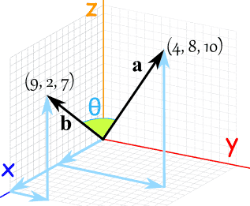
Geometrical interpretation of dot product
Vector with n elements can be represented by arrow in n-dimensional space.
Arrow has direction and length
Notes:
All these vectors have the same magnitude = 5.

Slide 53
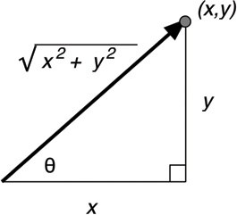
Dot product of vector with self = length²
Let A = [x, y] be a two-dimensional vector
Then A • A = x² + y² = hypotenuse²

Slide 54
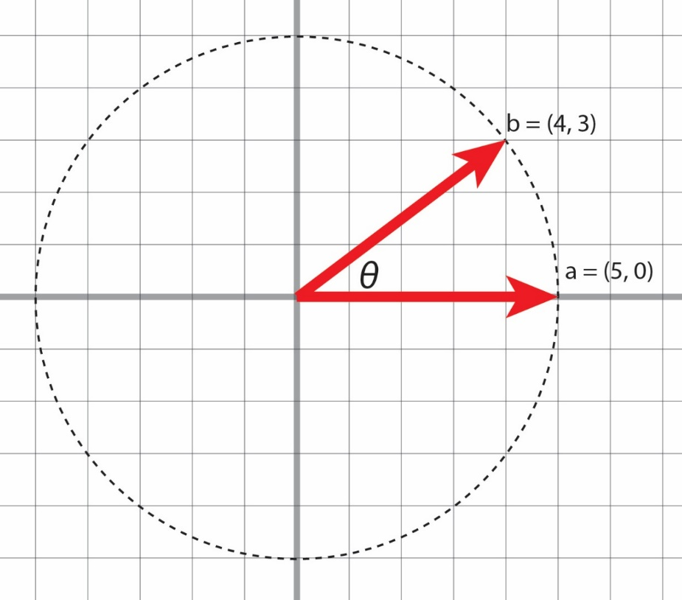
Two vectors of magnitude 5:
a = (5, 0)
a • a = 25 = |a|²
b = (4, 3)
b • b = 4² + 3²
= 16 + 9
= 25
= |b|²
Notes:
All these vectors have the same magnitude = 5.

Slide 55
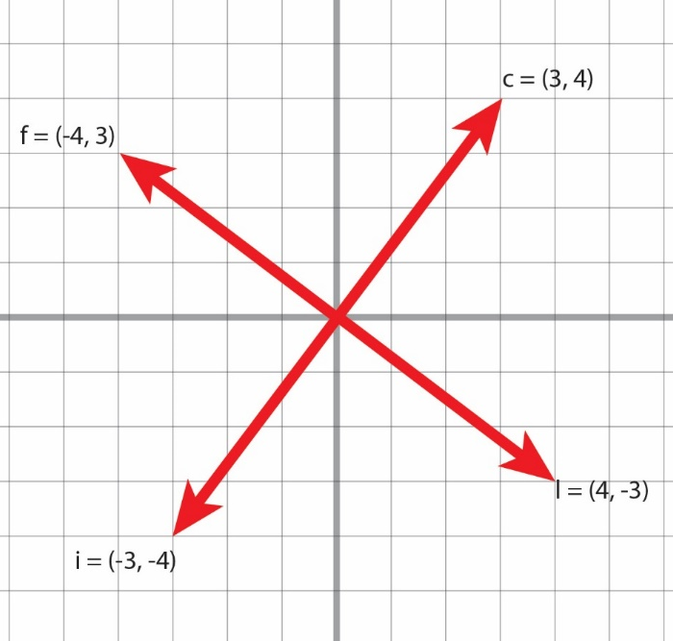
Orthogonal vectors
(+3,+4) • (-4,-3) = -12 + 12
= 0
Notes:
All these vectors have the same magnitude = 5.

Slide 56
Opposite direction vectors
(3,4) • (-3,-4) = -9 – 16
= - 25
Notes:
All these vectors have the same magnitude = 5.

Slide 57
Neither parallel nor orthogonal
a = (+5, 0)
b = (+4, +3)
a • b = 5 * 4 = 20
Notes:
All these vectors have the same magnitude = 5.

Slide 58
Rewrite using trigonometry
a = (+5, 0)
b = (+4, +3)
cos θ = adjacent / hypotenuse = 4/|b|
→4 = |b|cos θ
a • b = sum of pairwise products
= 5 * 4
= |a|*(|b|cos θ)
= |a||b|cos θ
|b|=5
=36.87°
b_{x} =4
Notes:
All these vectors have the same magnitude = 5.

Slide 59
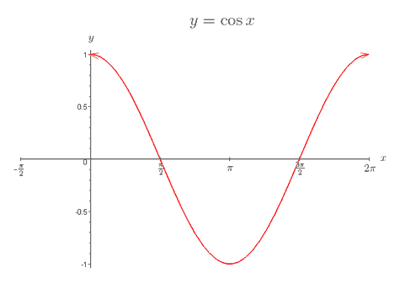
Cosine function is +1 when θ = 0, zero when θ = 90 or 270.
36.9 deg (example we just saw)
0 deg = parallel
90 deg = orthogonal
180 deg = opposite directions
Notes:
All these vectors have the same magnitude = 5.

Slide 60
Can prove (not here) that cosine formula is true for any 2 vectors, in any number of dimensions:
a • b = |a||b|cos θ
where θ is angle between a, b in n-dimensional space.

Slide 61
How do we define θ if dimensions>3?
There will be some 2D plane containing both vectors, even if embedded in a high-dimensional space.
Define angle in this plane

Slide 62
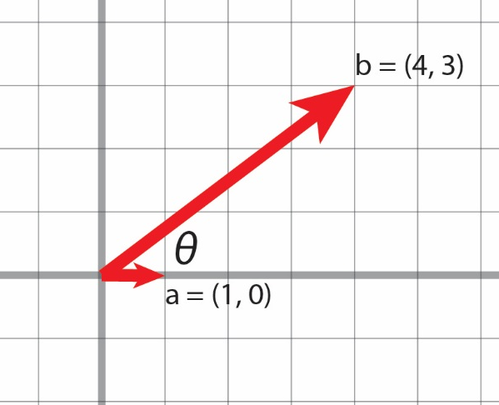
Terminology: “unit” vector, length = 1.0
Can create by dividing any vector by its own magnitude.
b̂ = b / |b| = (4/5, 3/5) = (0.8, 0.6)
Verify:
0.8² + 0.6² = 0.64 + 0.36 = 1.00
(0.8, 0.6)
b̂
Notes:
All these vectors have the same magnitude = 5.

Slide 63

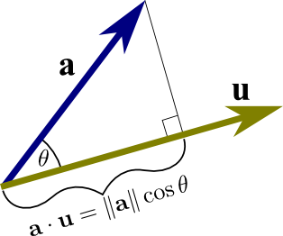
Dot product with any unit vector = length of shadow
Dot product of “a” with unit vector “u” is length of the “shadow” of “a” onto “u”
Notes:
Using the definition of cosine, we can “prove” the dot product for the special case where one vector lies along the x-axis.

Slide 64
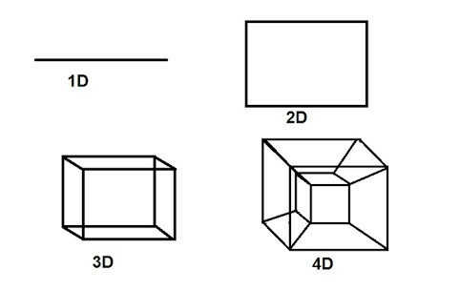
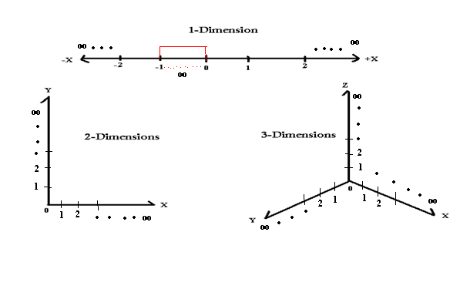
How can we visualize dot product involving > 3 dimensions?
5D, etc
?
?

Slide 65
Each axis must be perpendicular to the existing ones. Can’t do this after 3
5D, etc
?
?

Slide 66
Try a completely different approach
a₄*b₄ = +4
A | B
-2 | -2
-1 | -1
1 | 1
2 | 2
a₃*b₃ = +1
a₂*b₂ = +1
a₁*b₁ = +4

Slide 67
Two 4-D vectors define 4 pairs of x,y coordinates
A | B
-2 | -2
-1 | -1
1 | 1
2 | 2

Slide 68
Dot product = + 10
a₄*b₄ = +4
A | B
-2 | -2
-1 | -1
1 | 1
2 | 2
a₃*b₃ = +1
a₂*b₂ = +1
a₁*b₁ = +4
All pairwise products are positive in top-right, and bottom-left quadrants

Slide 69
Rearrange “b” to get new points:
a₁*b₁ = -4
A | B
-2 | 2
-1 | 1
1 | -1
2 | -2
a₂*b₂ = -1
a₃*b₃ = -1
a₄*b₄ = -4
Dot product = - 10
Note that points in lower right, and upper left, contribute to negative sum

Slide 70
Now dot product = -10
a₁*b₁ = -4
A | B
-2 | 2
-1 | 1
1 | -1
2 | -2
a₂*b₂ = -1
a₃*b₃ = -1
a₄*b₄ = -4
All pairwise products are positive in top-right, and bottom-left quadrants

Slide 71

25-D example:
(a₁, a₂, a₃, …) • (b₁, b₂, b₃, …) = $\sum_{i=1}^{n}{a_{i}b_{i}}$
Two 25-D vectors, A, B
A | B
0.256574 | -0.47409
-1.06162 | 0.104613
0.205486 | 1.000592
1.381874 | 1.641875
-0.3789 | -1.03427
1.32869 | 0.189985
1.344438 | 1.911619
1.461591 | 0.914581
1.554256 | 0.737026
0.889833 | 0.963659
-1.24735 | -0.24158
-0.75902 | -1.52722
-1.43461 | -0.8119
-0.00607 | 0.716201
-0.26062 | -0.11456
-0.54498 | -1.19385
0.328155 | 1.284383
-1.16679 | -0.55996
-0.05578 | -0.48953
-1.24326 | -0.80473
1.313789 | 1.361102
0.58111 | -0.63932
-0.06765 | -0.30031
-1.54698 | -0.91348
-0.87219 | -1.72084

Slide 72
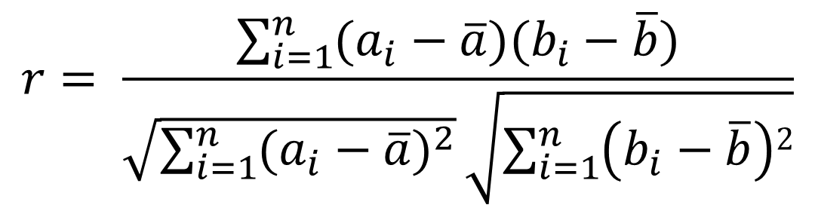
Take a look at formula for Pearson’s cross-correlation “r”:
From Wikipedia:
$$r= \frac{\sum_{i=1}^{n}{(a_{i}−\overline{a})(b_{i}−\overline{b})}}{\sqrt{\sum_{i=1}^{n}{{(a_{i}−\overline{a})}^{2}}}\sqrt{\sum_{i=1}^{n}{\left(b_{i}−\overline{b}\right)2}}}$$

Slide 73

Remember that $\overline{a}$ indicates mean of all elements in $a$.
$$r= \frac{\sum_{i=1}^{n}{(a_{i}−\overline{a})(b_{i}−\overline{b})}}{\sqrt{\sum_{i=1}^{n}{{(a_{i}−\overline{a})}^{2}}}\sqrt{\sum_{i=1}^{n}{\left(b_{i}−\overline{b}\right)2}}}$$

Slide 74
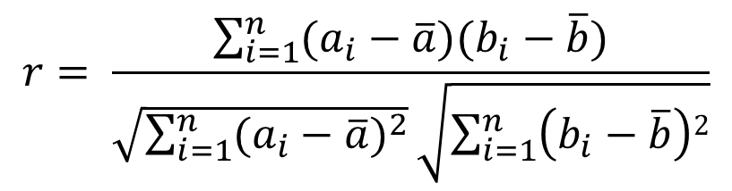
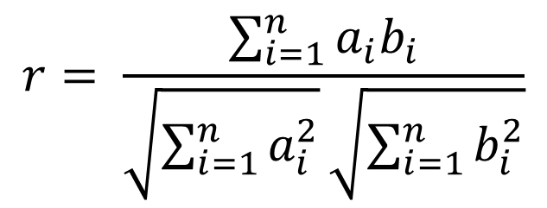
Suppose both vector means = 0:
$$r= \frac{\sum_{i=1}^{n}{(a_{i}−\overline{a})(b_{i}−\overline{b})}}{\sqrt{\sum_{i=1}^{n}{{(a_{i}−\overline{a})}^{2}}}\sqrt{\sum_{i=1}^{n}{\left(b_{i}−\overline{b}\right)2}}}$$
$$r= \frac{\sum_{i=1}^{n}{a_{i}b_{i}}}{\sqrt{\sum_{i=1}^{n}{a_{i}^{2}}}\sqrt{\sum_{i=1}^{n}{b_{i}^{2}}}}$$

Slide 75
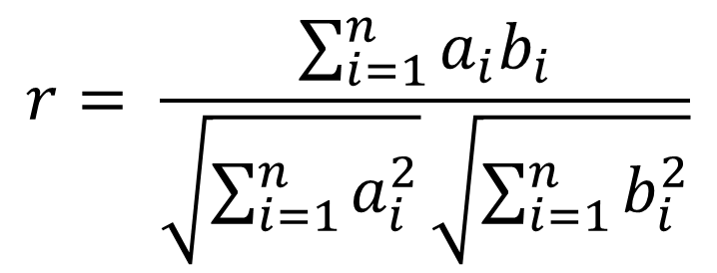
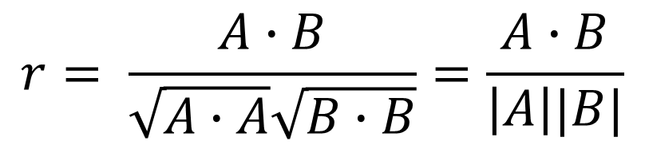
Can simplify even more:
$$r= \frac{\sum_{i=1}^{n}{a_{i}b_{i}}}{\sqrt{\sum_{i=1}^{n}{a_{i}^{2}}}\sqrt{\sum_{i=1}^{n}{b_{i}^{2}}}}$$
$$r= \frac{A∙B}{\sqrt{A∙A}\sqrt{B∙B}}=\frac{A∙B}{\left|A\right||B|}$$

Slide 76

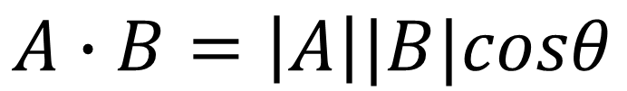
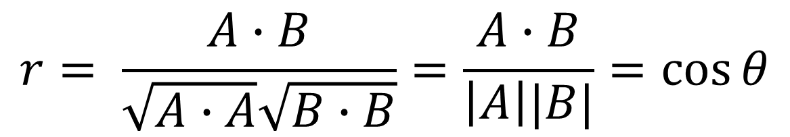
Remember from slide #60:
$$A∙B=\left|A\right||B|cosθ$$
$$cosθ=\frac{A∙B}{\left|A\right|\left|B\right|}$$
$$r= \frac{A∙B}{\sqrt{A∙A}\sqrt{B∙B}}=\frac{A∙B}{\left|A\right||B|}=\cos{θ}$$

Slide 77
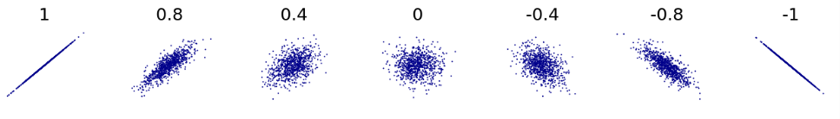
Pearson’s r = cos θ:
Pearson’s r is basically a normalized dot product.
Both measure pairwise similarity between sets of numbers.
Most similar
Most inversely similar
Not similar at all

Slide 78
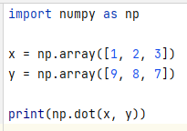
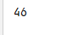
Dot products in Python

Slide 79
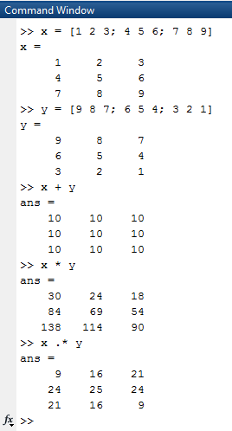
Sometimes we need to do a lot of dot products:

Slide 80
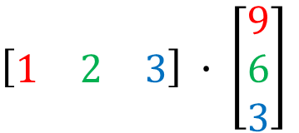
Conventional way to write dot product
First vector drawn horizontally, second one is vertical.
This order is very important.
$\left[\begin{matrix}1 & 2 & 3\end{matrix}\right] ∙ \left[\begin{matrix}9 \\ 6 \\ 3\end{matrix}\right]$
= 1 * 9 + 2 * 6 + 3 * 3 = 9 + 12 + 9 = 30

Slide 81
The end

Slide 82
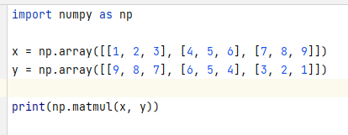
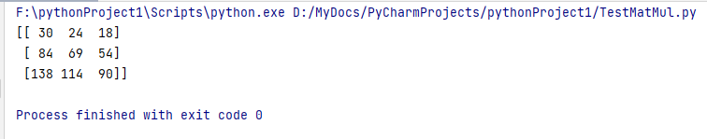
Matrix multiplication in Python

